Slide 1
Project 3
AI-Driven Recipe Generator and Visualization

Slide 2
Project introduction
🔹 Objective: Create an AI-powered recipe generator that suggests meals based on available ingredients.
🔹 How It Works:
Input Ingredients → User adds available ingredients.
Recipe Generation → AI suggests recipes using trained models.
Step-by-Step Instructions → AI provides cooking directions.

Slide 3

Technology used
Technology Used:
Machine Learning & NLP → Ingredient matching & recipe generation.
Gradio UI → Interactive and user-friendly interface.
Custom Trained Model → Replaces initial reliance on Gemini API.

Slide 4

Dataset
Dataset: AkashPS11/recipes_data_food Recipe Dataset
A large-scale dataset containing recipes, ingredients, and cooking instructions.
Used to train the AI for ingredient-to-recipe and recipe-to-instruction generation.
Key Components:
Ingredients Data → Standardized names, quantities, and units.
Recipe Metadata → Recipe names, descriptions, and structured instructions.
Preprocessed JSON Files → Cleaned and formatted data for model training.

Slide 5

Project Challenges
1. Model Training Issues
Difficulty in training the AI model due to dataset complexity.
Errors in initial model implementation required a complete refactor.
2. Data Cleaning & Normalization
Standardizing ingredient names, units, and quantities was time-consuming.
Ensuring accurate ingredient-to-recipe matching.

Slide 6
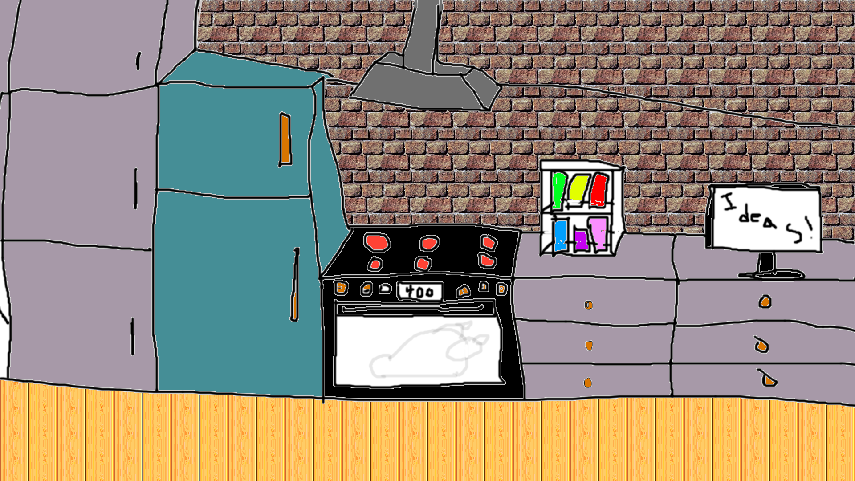
UI
Gradio ui explanation

Slide 7
How to use Software
Go to pantry to add in ingredients that you have on hand, both staples and fresh ones.
Go to the cookbooks to have the model focus on specific diets or cuisines.
Go to computer to find flavor pairings based on what you have to create a smaller pantry and use those to find a recipe based off of a more narrow selection.
Finally, go to the stove to generate recipes based off of the pantry, diet, cuisines, and flavor pairings.

Slide 8
Future Improvements & Next Steps
We could improve model accuracy with more different datasets
We could use a cleaner dataset for training
Optimize processing speed for faster recipe matching

Slide 9

Questions

